Slide 1

Covid NLP Analysis
Juzheng Shi
Qian Gao

Slide 2



Agenda
Project Scope
Data Description & Visualization
Data Processing & Analysis
Findings & Conclusions

Slide 3

Project Scope

Slide 4
Project Scope
Programming Language: Python
Packages Used: nltk, re, string, pandas, numpy, seaborn, matplot
Data Source: Tweeter
Project Focus: Sentiment Analysis

Slide 5
Data Description & Visualization

Slide 6
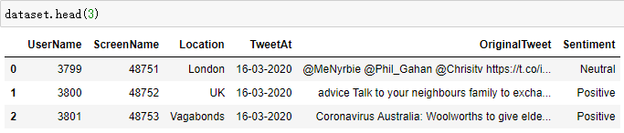
Data Description
Data Link: https://www.kaggle.com/datasets/datatattle/covid-19-nlp-text-classification?select=Corona_NLP_test.csv
Data Size: 41,157 rows x 6 columns
Data Features: Location, Tweet Date, Original Text
Dropped Features: User Name, Screen Name
Target Column: Sentiment

Slide 7
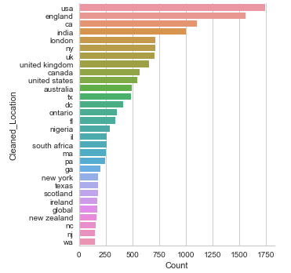
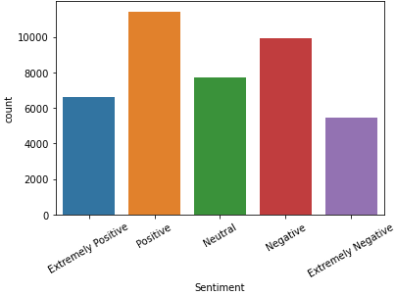
Data Visualization
Tweet count by location
Tweet count by sentiment

Slide 8
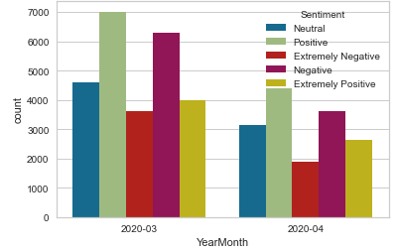
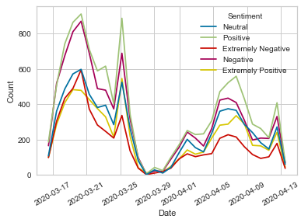
Data Visualization
Tweet count for different month
Sentiment trend through the month

Slide 9
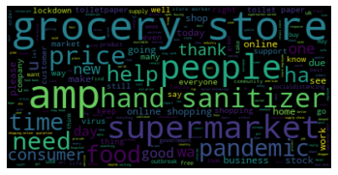
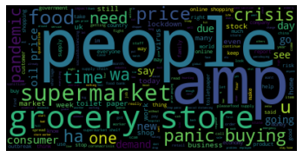
Data Visualization
Positive Wordcloud
Negative Wordcloud
Notes:
Covid is removed as a stop word

Slide 10
Data Processing & Analysis

Slide 11
Data Processing
Data Cleaning
Removed Punctuation
Removed Numbers
Removed Stopwords
Removed Space
Removed Url
Removed Ascii code
Preprocessing
Lower Cased
Tokenization
Lemmatization
Vectorization

Slide 12
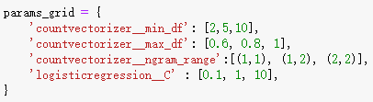
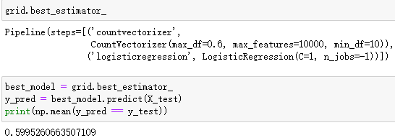
Modeling Benchmark
CountVectorizor & Logistic Regression
GridSearchCV
Model Improvements
Lightgbm
Word2Vec

Slide 13
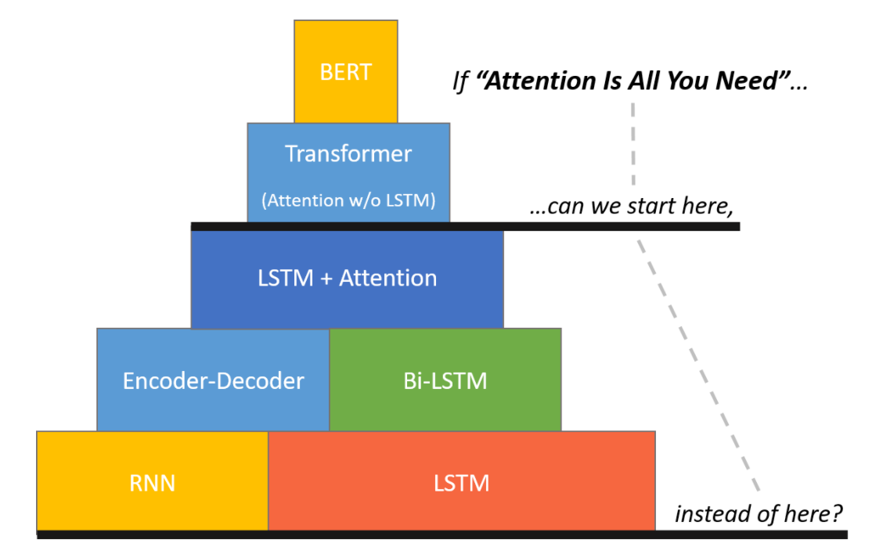
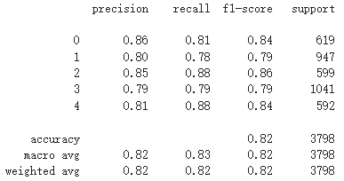
Bert
Model Description
Neural network based on Transformers
1.1 Million Parameters
Utilizing pre-trained model due to limited on-hand dataset
https://towardsdatascience.com/wordpiece-subword-based-tokenization-algorithm-1fbd14394ed7

Slide 14
Findings & Conclusions

